Slide 1
Loops and practice

Slide 2
Loops
This is something that we can see in almost every single programming language.
Loops save our time by executing repetitive code multiple times
In loops we control how many times same code will repeat
In loops we control what happens many times
And we control what conditions must be met to execute or exit the loop
Most famous are: for and while

Slide 3
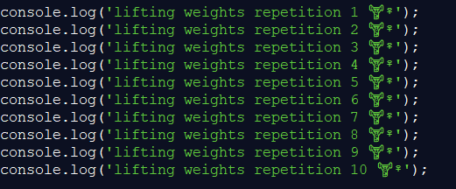


For loop

Slide 4
For loop
In C# and C++ goes like this:
for (int i = 1; i <= 30; i++)
In JS we have similar thing, just remember we use let instead of int:
for (let i = 1; i <= 30; i++)
In example in previous slide we have different name of the variable – there it is called rep

Slide 5
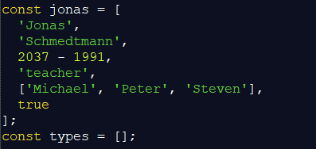
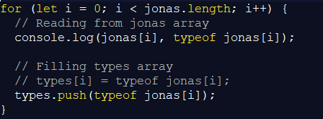
Looping through the array

Slide 6
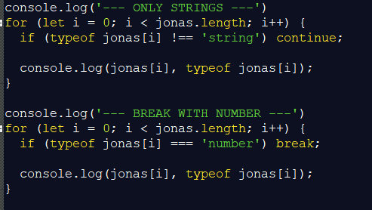
Continue and break

Slide 7

Going backwards

Slide 8

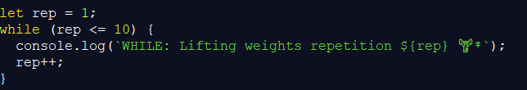
While loop
Instead of for loop
you can use while loop

Slide 9
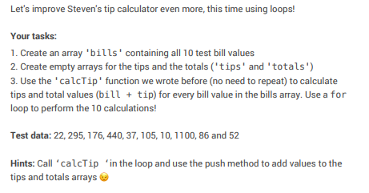
Coding challenge

Slide 10
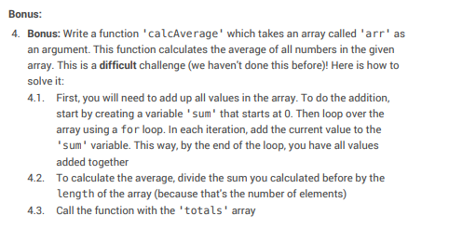
Coding challenge (2nd part)

Slide 11
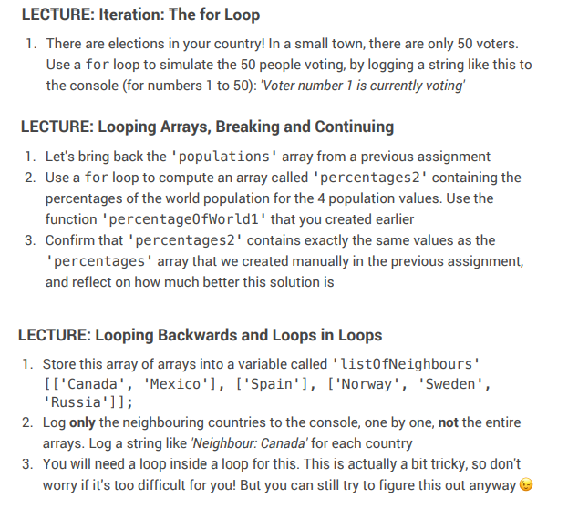
Challenge or Homework part 1

Slide 12
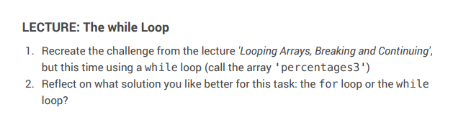
Challenge or Homework part 2

